Slide 1

New DIN reports for brachytherapy
Frank Hensley
04/1990 -11/2014: Universitätsklinikum Heidelberg,
Dept. Radioonkologie und Strahlentherapie
frank.hensley@gmx.de

Slide 2
Disclosures:
Member of NAR-AA1: DIN Committee for standards in dosimetry
Chair of WG DIN 6803-3
No financial conflicts of interest

Slide 3
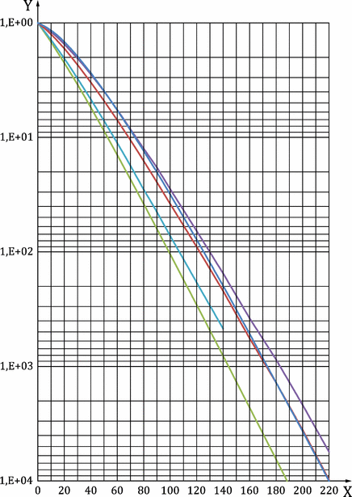
DIN 6853-2 : 2021-08
Medizinische ferngesteuerte, automatisch betriebene Afterloading-Anlagen
Teil 2: Strahlenschutzregeln für die Errichtung
Medical remote-controlled automatically-driven afterloading systems - Part 2: Radiation protection rules for installation
Previous release: 6853-2:2005-10
a. Adaptation to the new radiation protection law (StrlSchG 2017);
b. Inclusion of transition factors for Co-60 as source material
c. tables of transition factors additional to graphs
d. editorial revision
⁶⁰Co
Tabelle A.3 — Schwächungsfaktoren F für 60Co als Funktion der Schichtdicke verschiedener Abschirmstoffe
Flächen­dichte | Schwächungsfaktoren F
d*ρ | Normalbeton | Barytbeton | Blei | Eisen | Bleiglas
[g/cm²] |  |  |  |  | 4,36 g/cm³
0,0 | 1,000E+00 | 1,000E+00 | 1,000E+00 | 1,000E+00 | 1,000E+00
0,5 | 1,003E+00 | 1,007E+00 | 1,015E+00 | 1,005E+00 | 1,013E+00
1,0 | 1,008E+00 | 1,018E+00 | 1,034E+00 | 1,013E+00 | 1,030E+00
2,0 | 1,021E+00 | 1,039E+00 | 1,073E+00 | 1,029E+00 | 1,065E+00
3,0 | 1,035E+00 | 1,062E+00 | 1,115E+00 | 1,047E+00 | 1,101E+00
4,0 | 1,049E+00 | 1,086E+00 | 1,158E+00 | 1,065E+00 | 1,139E+00
6,0 | 1,081E+00 | 1,138E+00 | 1,250E+00 | 1,105E+00 | 1,220E+00
8,0 | 1,118E+00 | 1,194E+00 | 1,352E+00 | 1,149E+00 | 1,308E+00
10,0 | 1,160E+00 | 1,256E+00 | 1,466E+00 | 1,197E+00 | 1,405E+00
140,0 | 1,968E+02 | 2,183E+02 | 8,074E+02 | 1,535E+02 | 4,672E+02
160,0 | 5,184E+02 | 5,687E+02 | 2,289E+03 | 3,787E+02
180,0 | 1,381E+03 | 1,378E+03 | 6,450E+03 | 8,663E+02
200,0 | 3,667E+03 | 3,574E+03 | 1,842E+04 | 2,157E+03
220,0 | 9,998E+03 | 9,765E+03 | 5,322E+04 | 5,568E+03
Flächendichte [g/cm²]

Slide 4
DIN 6853-5 : 2021-08
Medizinische ferngesteuerte, automatisch betriebene Afterloading-Anlagen
Teil 5: Konstanzprüfung von Kennmerkmalen
Medical remote-controlled automatically-driven afterloading systems - Part 5: Constancy testing of characteristics
Previous release: DIN 6853-5:2012-09
Mainly editorial updates:
  Update of references to new radiation protection regulations (StrlSchV 2018) and updated standards:
  E DIN EN 60601-2-1:2008-07 ➔ DIN EN 60601-2-1:2016-08
  DIN 6847-5:1998-01 ➔ DIN6847-5:2013-10 (constancy tests of Linacs)
  DIN 6814-3:2001-01 ➔ DIN6814-3:2016-08 (Terms in dosimetry)
  . . .
  Inclusion of a new paragraph 3: Terms and definitions (standard paragraph in DIN standards)
  details of constancy tests, previously in para 3 ➔ para 4

Slide 5
DIN 6827-3 : 2021-09
Protokollierung bei der medizinischen Anwendung ionisierender Strahlung
Teil 3: Brachytherapie mit umschlossenen Strahlungsquellen
Recording in medical application of ionizing radiation - Part 3: Brachytherapy with enclosed radiation sources
Previous release: DIN 6827-3:2002-12
adaptation of structure to EBRT- standard DIN 6827-1
inclusion of electronic recording
requirement of departmentally defined working procedures for electronic signatures para 4.2.1
Rules (items) for interplay of recording and Quality Mangement System
QMS recommended in RL.Strl.Sch.Med. (2011) para 7.3, DIN 6870-1 : 2009
recommendation to define procedures in the QMS : 4.2.8.7
- for positioning
- position verification
- dose verification
tolerances for dose and positioning see also SSK-Stellungnahme v. 15./16.02.2018
- are defined in QMS
- exceeding of limits must be recorded
Adverse events („bedeutsame Vorkommnisse“) must be recorded :
in connection with § 90 Strl.Sch.G. (2017)
4.3.3.8 Bedeutsame Vorkommnisse
Treten Ereignisse auf, die den Behandlungserfolg gefährden oder dem Patienten Schaden zufügen könnten, sind die Umstände und mögliche Folgen, einschließlich getroffener Maßnahmen, zu protokollieren.
ANMERKUNG Dazu zählt zum Beispiel eine Unter- bzw. Überdosierung in Relation zur Dosierungsverordnung
Unabhängig von der patientenspezifischen Protokollierung sind in diesem Fall auch die gesetzlichen Anforderungen, z.B. Meldepflichten und Maßnahmen zur zukünftigen Fehlervermeidung usw., zu beachten.

Slide 6
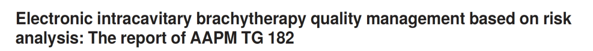
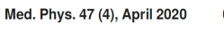
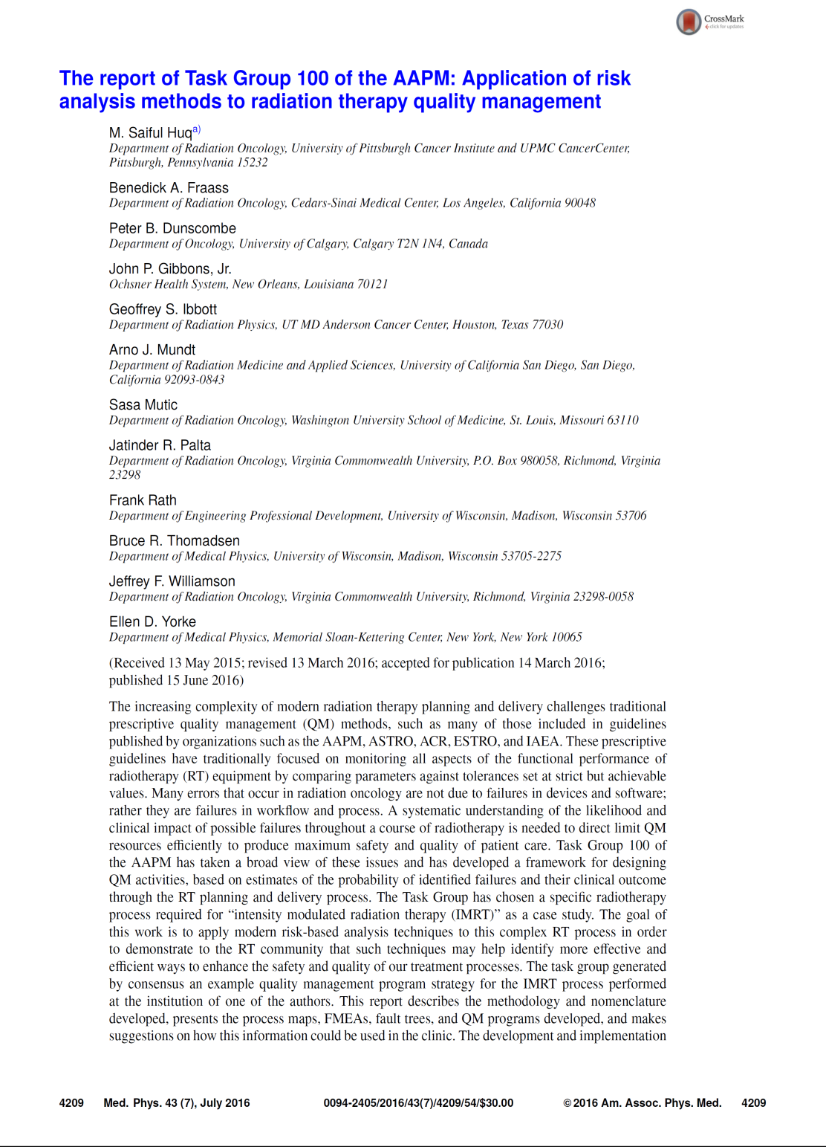


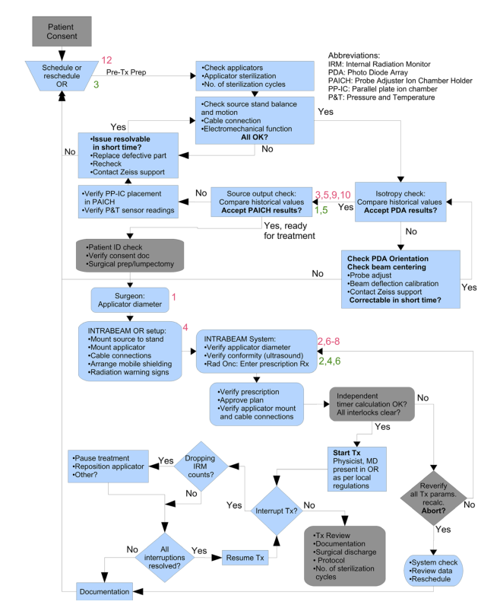
Adverse Events and Quality Management
➔ application of AAPM TG 100 to electronic brachytherapy
Session at AAPM 2021
TG182 MP 2020

Slide 7
DIN 6827 -3 : 2021-09
Protokollierung bei der medizinischen Anwendung ionisierender Strahlung
Teil 3: Brachytherapie mit umschlossenen Strahlungsquellen
DIN 6827-3 recommends:
documentation of calculation algorithm 4.8.2.5
documentation of accumulated dose after each irradiation: 3.2 , 4.3.3.5
  - at dose reference point
  - not required by DIN, but also reasonable: at dose points in OARs
  - after every fraction, every interruption
Documentation of deviations of irradiation parameters from tolerance levels pre-set in the QM-System :
4.3.3.6 Abweichungen von den Sollwerten der BESTRAHLUNGSPARAMETER
Bei Abweichungen der BESTRAHLUNGSPARAMETER von ihren Sollwerten sind alle Angaben zu protokollieren, mit deren Hilfe klinisch relevante Auswirkungen auf die berechnete dreidimensionale Verteilung der Energiedosis abgeschätzt werden können. Eine Abweichung vom Sollwert eines BESTRAHLUNGSPARAMETER liegt dann nicht vor, wenn im QM-System der Klinik für den Parameter ein Toleranzbereich vorgegeben ist und der Parameterwert innerhalb des Toleranzbereiches liegt.
Abweichungen von den Sollwerten der BESTRAHLUNGSPARAMETER liegen auch dann vor, wenn eine BESTRAHLUNG gewollt oder ungewollt vorzeitig beendet wurde.

Slide 8
DIN 6827 -3 : 2021-09
Protokollierung bei der medizinischen Anwendung ionisierender Strahlung
Teil 3: Brachytherapie mit umschlossenen Strahlungsquellen
old „recording levels“ („Protokollierungsstufen“) are cancelled
originally (in 1995) intended to give detailed recommendations how to record
plans, typically using radiographs or US for applicator localization
Level 1: Without applicator reconstruction
dose calculation in single points using tables
Level 2: Typically TPS-planned applications
Plans reconstructing the applicator and generating dose distribuions
Level 3: CT-based plans showing dose distributions on the patient anatomy
generation of treatment parameters such as dwell positions and times by the TPS
New standard refers to ICRU reports (38, 58, 50, 62)
for
  definitions of reference doses
  documentation of application
  recording

Slide 9
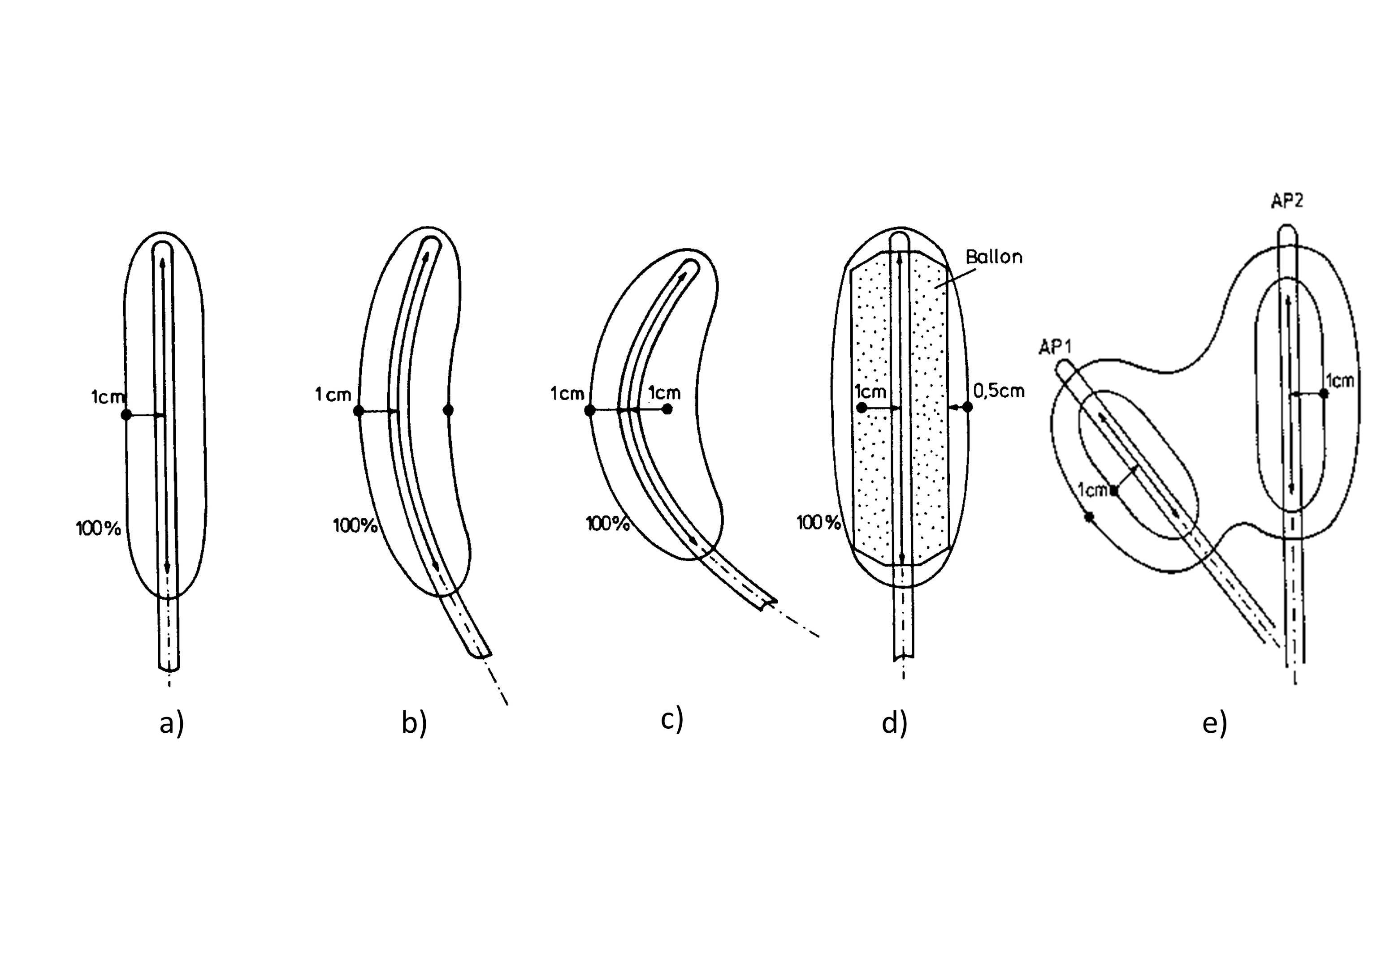
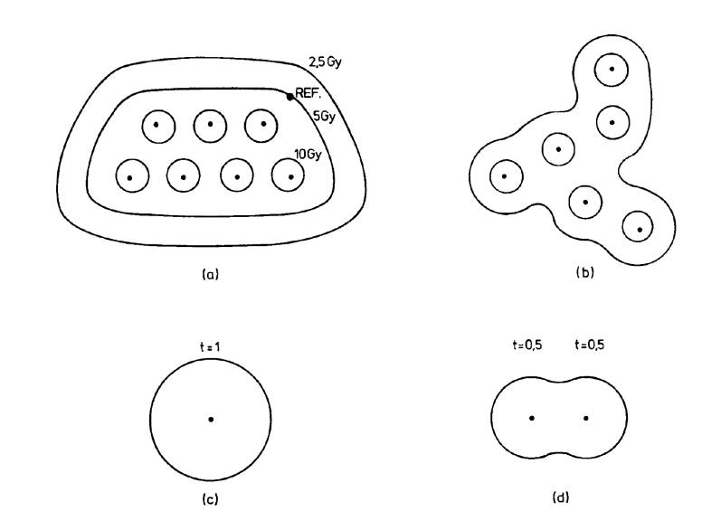
DIN 6827 -3 : 2021-09
Protokollierung bei der medizinischen Anwendung ionisierender Strahlung
Teil 3: Brachytherapie mit umschlossenen Strahlungsquellen
Previous appendices describing the definition of reference points in different situations are cancelled reference to ICRU reports
Old standard should be kept as reference and for teaching purposes
Information also available in DGMP Report 14
DIN 6827-3 : 2003-12

Slide 10
DIN 6803
Since 2012 :
DIN series 6803: Dosimetrie für die Photonen-Brachytherapie
Meant to give more space for detailed recommendations for brachytherapy
DIN 6803-1: special terms and defintions in Brachytherapy
published 05-2019
present discussion that the definitions of DIN-6803-1 should possibly be re-integrated into DIN 6814 (DIN 6814-3 : Terms in dosimetry)
DIN 6803-2 Dose calculation and QA
published 12-2020
DIN 6803-3 Dosimetry of HE photon sources for Brachytherapy
work in progress
DIN 6803-4: Dosimetry of electronic brachytherapy
work in progress

Slide 11
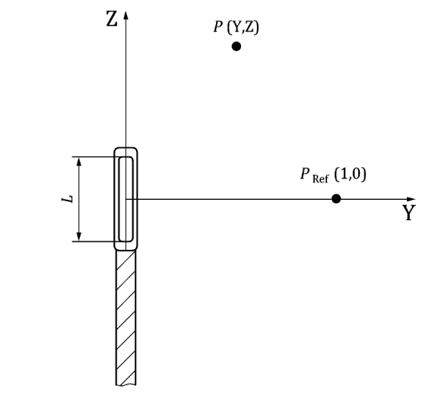
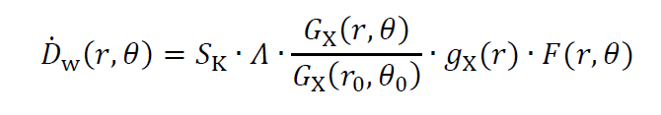
DIN 6803-2 : 2020-12
Dosimetrie für die Photonen-Brachytherapie
Teil 2: Strahler, Strahlerkalibrierung, Strahlerprüfung und Dosisberechnung
Dosimetry for Photon Brachytherapy — Part 2: Radiation sources, source calibration, source test and dose calculation
TG43 is recommended as standard method for the calculation of dose distributions from HE and LE Brachytheapy sources
  S_{K} („Luftkerma-Stärke“)
  is recommended as the standard quantity for source calibration
  (as well as the other TG43 calculation parameters for calculation)
  Calculation rules and examples using TG43 data
  Information on calculation uncertainties
  Interpolation rules
  Instructions for manual calculation of treatment times for permanent and temporary implants
DIN 6803-2 : 2020-12

Slide 12
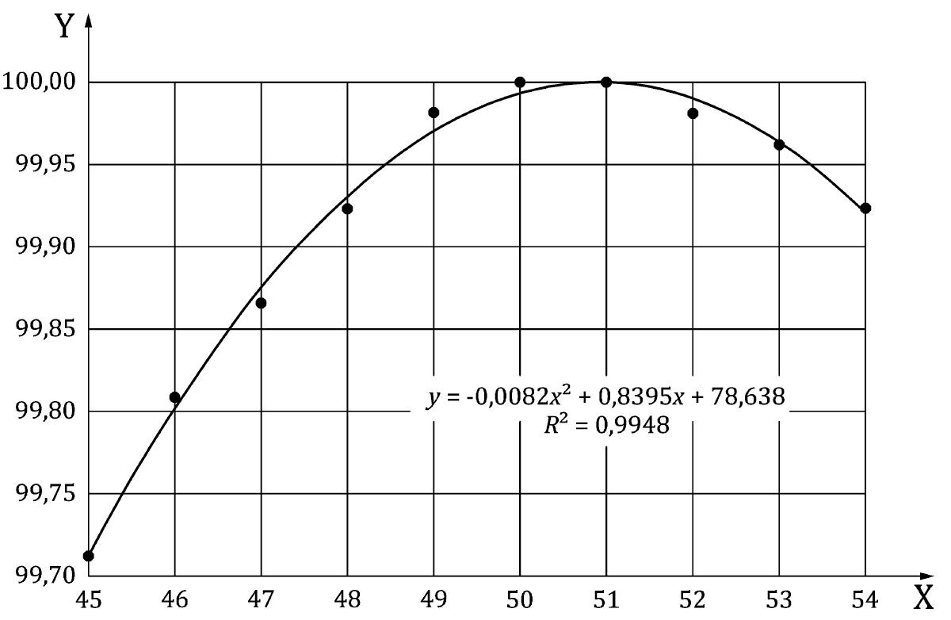
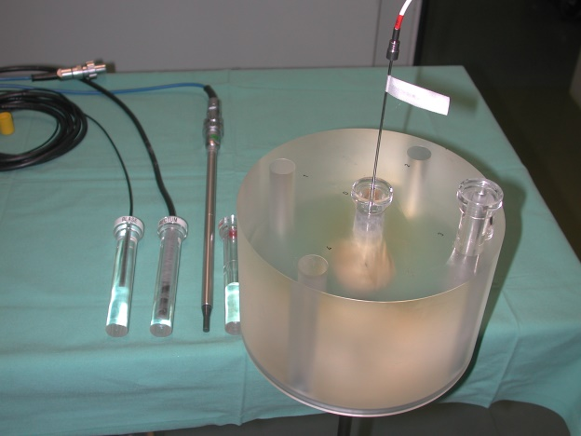
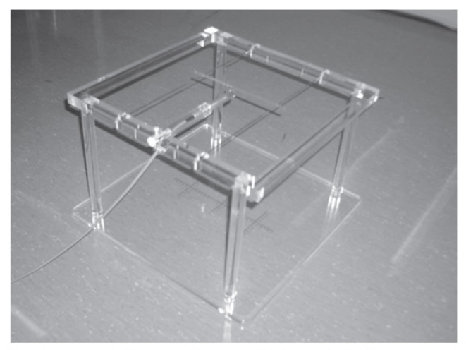
DIN 6803-2 : 2020-12
Strahler, Strahlerkalibrierung, Strahlerprüfung und Dosisberechnung
Verification of source calibration
with calibrated well chambers
Otherwise verification recommeded only with officially calibrated arrangements of chamber and phantom (kalibrierte Dosimeter-Phantom-Anordnungen)
Determination of „sweet spot“
Williamson, Kahn Radiology 1982
DIN 6803-2 : 2020-12
GEC-ESTRO Physics Booklet No.5

Slide 13
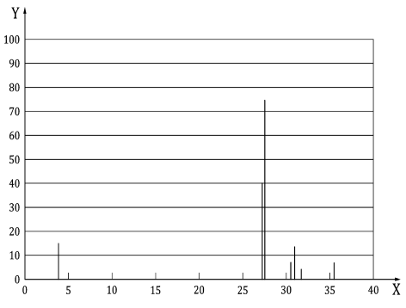
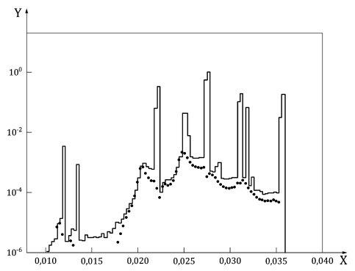
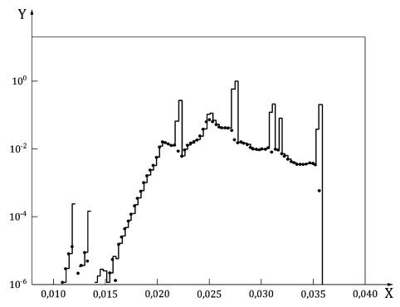
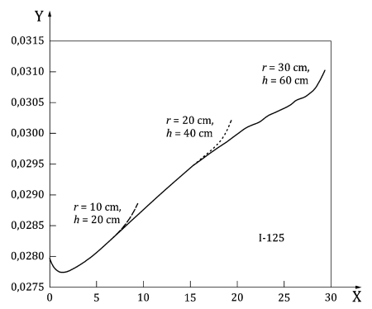
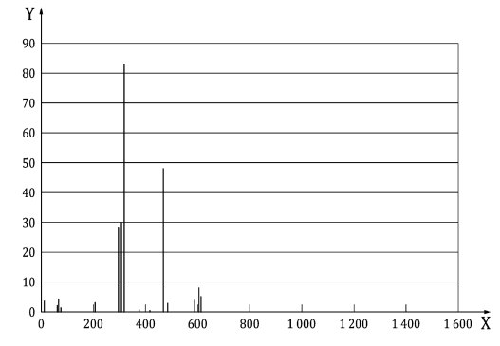
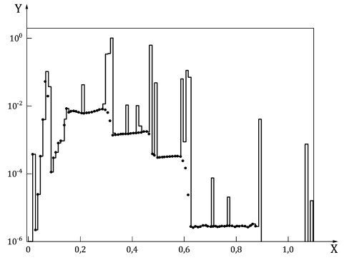



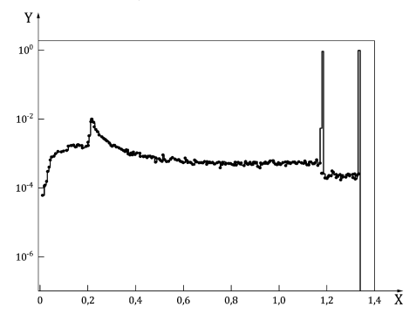
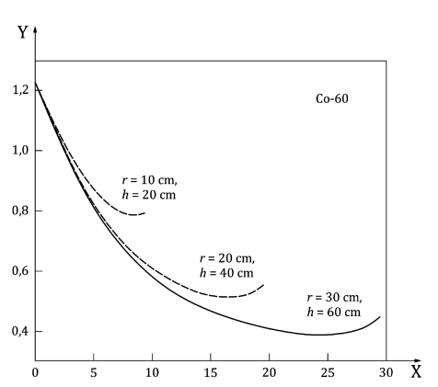

DIN 6803-2 : 2020-12
Strahler, Strahlerkalibrierung, Strahlerprüfung und Dosisberechnung
Information on local variation of spectra and mean energy
Information on dependence of dose (rate) on phantom size
Emission spectrum
Spectrum at source surface
Spectrum at 1cm in water
Mean energy
¹²⁵ I
Mean energy / keV or MeV
Photon fluence [arbitrary units]
¹⁹² Ir
⁶⁰ Co
DIN 6803-2 : 2020-12
Photon energy / keV (¹²⁵I) or MeV (¹⁹²Ir, ⁶⁰Co)
Distance from source in water / cm
DIN 6803-2 : 2020-12

Slide 14
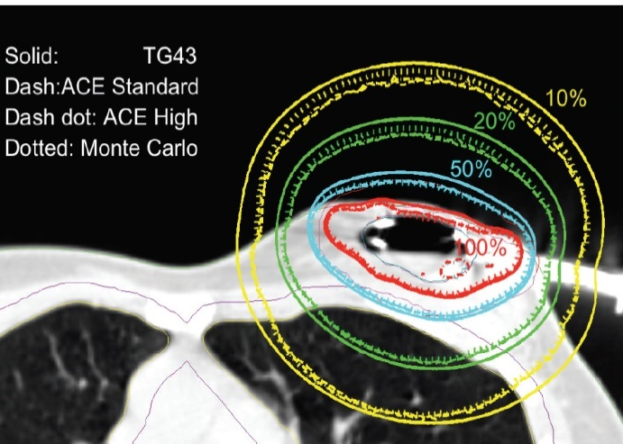
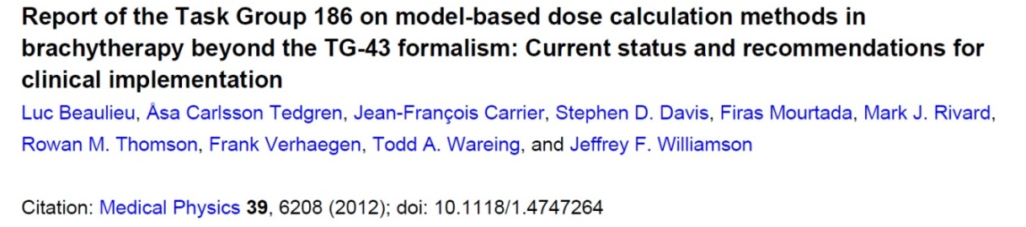
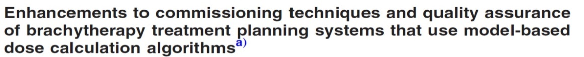
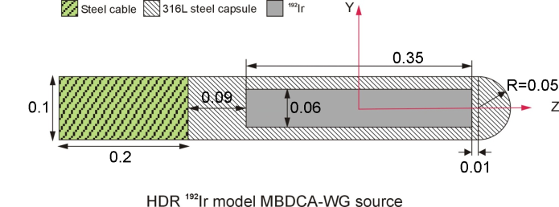
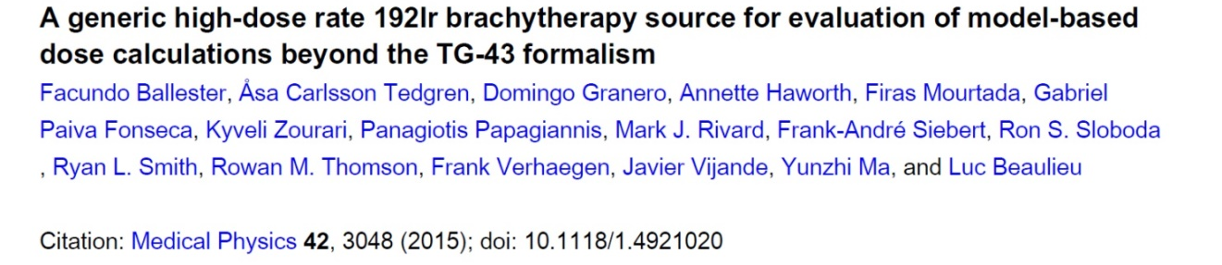
DIN 6803-2 : 2020-12
Strahler, Strahlerkalibrierung, Strahlerprüfung und Dosisberechnung
Calculations with model based algorithms :
reference to recommendations of TG186
and MBDCA-WG Working Group on Model Based Dose Calculation Algorithms
need of extended commissioning :
reference to recommendations of MBDCA-WG
Van Veelen ACE White Paper Elekta 2014
Marc Rivard, Luc Beaulieu, Firas Moutarda Med.Phys. 37 (2010) 2645
GEC ESTRO Data Base

Slide 15






DIN 6803-3 - Work in progress
NAR assignment to develop recommendations for experimental dosimetry for HE sources, for LE sources, later
proposed formalism :
$$D\left(r,θ\right)=M∙N∙k_{Q,R}∙k_{NR}(r,θ)∙\prod{k_{i}}$$
Development of correction factors for differing energy and fluence distribution :
Correction factors determined by MC calculations
Must be seen in the German tradition to publish codes of practice in dosimetry as DIN standards (and not, e.g. as DGMP reports)
$N$ :
$k_{Q,R}$:
$k_{NR}(r,θ)$ :
⁶⁰Co
¹⁹²Ir, ⁶⁰Co
defined at TG43 reference point (r=1cm, θ=90°)
➔talks by K. Büsing 19.09. 12:30
G. Rossi and Th. Failing 19.09 16:35

Slide 16
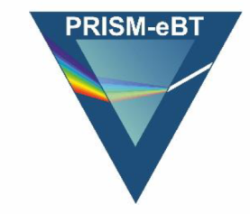

DIN 6803-4 - work in progress
NAR Charge: Development of transferrable reference calibration for eBT sources
in collaboration with
Euramet Project
Prism-eBT
Development of reference dosimtery
for kV Brachy/IORT devices: Intrabeam
• Method of measurement Papillon
• Detectors and corrections Xoft
Esteya
Womed ioRT-50
. . .
Research consortium of
6 European National Metrology Insitutes :
PTB D
CEA F
CMI Cz
ENEA I
NPL UK
VSL NL
3 Universities
MAASTRO Clinic NL
Aarhus U DK
Stichting RO NL
www.euramet.org/research-innovation/search-research-projects/

Slide 17

DIN 6803-4 - work in progress
Dosimetry of eBT sources
For low energy X-rays, most NMIs use calibrations based on
air Kerma at phantom surface
- in broad beam geometry
- plane parallel chambers
(TG 61, IPEMB, …)
with additional correction factors
for measurements in phantom :
- backscatter
- waterproofing
- divergence of radiation field
➔ corrections cause additional uncertainty
DIN 6809-4 : 2020-04 proposes direct beam calibration in terms of D_{W}
My personal idea: for LE and eBT sources use of similar formalism as developed in DIN 6803-3 for HE sources, similar calculations of correction factors.

Slide 18
Summary :
5 new DIN Standards on Brachytherapy since 2019
DIN 6853-2 : 2021-08 Radiation protection
inclusion of ⁶⁰Co
DIN 6853-5 : 2021-08 Quality Assurance
update to German Strl.Sch.G. (2017)
DIN 6827-3 : 2021-09 Recording radiation treatments
adapted to Quality Management System, report of adverse effects
DIN 6803-1 : 2019-05 Terms and definitions in dosimetry
DIN 6803-2 : 2020-12 Brachytherapy dose calculation
TG43 standard model for dose calculation
2 new standards work in progress
DIN 6803-3 Experimental dosimetry of HE sources
DIN 6803-4 Calibration of eBt sources

